Slide 1
Lists
Units 2.05 & 2.06

Slide 2
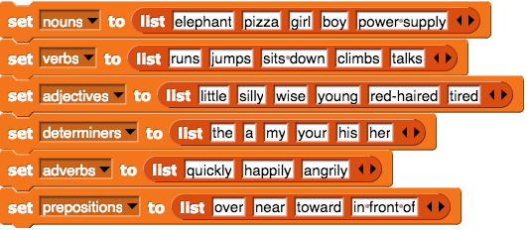
Flashback

Slide 3
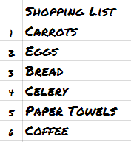
What is a list?

Slide 4
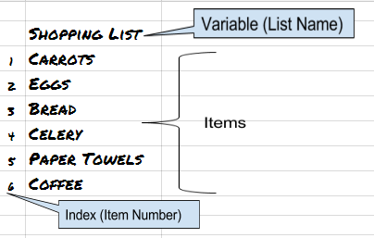
What is a list?

Slide 5
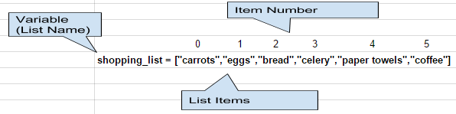
Creating a List in Python

Slide 6
Creating a List in Python
Python lists are enclosed in square brackets [ ]
Start by creating a variable and assigning it a list
shopping_list = [ ]
I

Slide 7
Creating a List in Python
Python lists can include strings, integers, floats or even another list. Separate list items with commas
shopping_list = [“carrots”,”eggs”,”bread”,”celery” ]
I

Slide 8
Traversing a List in Python
Items in Python Lists are numbered so you can manipulate list items individually.
Python lists start at zero 0
shopping_list = [“carrots”,”eggs”,”bread”,”celery” ]
0 1 2 3
I

Slide 9
Traversing a List in Python
The list item number is called an Index.
You can access an individual list index number or a range of list items.
The syntax used to access single item is
list_name[index number]
shopping_list = [“carrots”,”eggs”,”bread”,”celery” ]
>>> print(shopping_list[0])
carrots
I

Slide 10
Traversing a List in Python
To access a range of index items you can indicate where you would like to start and stop the range
The syntax used to access a range of items is
list_name[index number start:number stop]
shopping_list = [“carrots”,”eggs”,”bread”,”celery” ]
>>> print(shopping_list[0:3])
['carrots', 'eggs', 'bread']
I

Slide 11
Traversing a List in Python
Notice anything strange in the result?
list_name[index number start:number stop]
shopping_list = [“carrots”,”eggs”,”bread”,”celery” ]
>>> print(shopping_list[0:3])
['carrots', 'eggs', 'bread']
The last item will not be included it is the stopping point. This is an important note
I

Slide 12
Traversing a List in Python
This process is formally known as slicing
list_name[index number start:number stop]
We are slicing the list into a part of the list. The number to the left of the colon is the starting point
The number to the right is the stopping point. The result will include the item to the left of the stopping point index number but not include that item.
I

Slide 13
Traversing a List in Python
Accessing from right to left
list_name[index number start:number stop]
We can also access list items in the reverse direction using negative index numbers
shopping_list = [“carrots”,”eggs”,”bread”,”celery” ]
>>> print(shopping_list[-2])
bread
I

Slide 14
Traversing a List in Python
Accessing from right to left
list_name[index number start:number stop]
We can also slice a list in the reverse direction using negative index numbers
shopping_list = [“carrots”,”eggs”,”bread”,”celery” ]
>>> print(shopping_list[0:-2])
[‘carrots’,’eggs’]
I

Slide 15
Traversing a List in Python
Let’s try it out:
Here is a list
grandchildren = [“Bill”,”Angel”,”Jenny”,”Ralph”,”Sam”]
What will the output be from:
>>> print(grandchildren[3])
I

Slide 16
Traversing a List in Python
Let’s try it out:
Here is a list
grandchildren = [“Bill”,”Angel”,”Jenny”,”Ralph”,”Sam”]
What will the output be from:
>>> print(grandchildren[3])
Ralph
I

Slide 17
Traversing a List in Python
Let’s try it out:
Here is a list. Let’s slice it
grandchildren = [“Bill”,”Angel”,”Jenny”,”Ralph”,”Sam”]
What will the output be from:
>>> print(grandchildren[1:3])

Slide 18
Traversing a List in Python
Let’s try it out:
Here is a list. Let’s slice it
grandchildren = [“Bill”,”Angel”,”Jenny”,”Ralph”,”Sam”]
What will the output be from:
>>> print(grandchildren[1:3])
['Angel', 'Jenny']

Slide 19
Modifying a List in Python
Lists are Mutable. This means they can be changed.
We can modify a list element by changing the contents of the list index
grandchildren = [“Bill”,”Angel”,”Jenny”,”Ralph”,”Sam”]
grandchildren[1] = “Angie”
print(grandchildren)
['Bill', 'Angie', 'Jenny', 'Ralph', 'Sam']

Slide 20
Modifying a List in Python
Lists are Mutable. This means they can be changed.
We can add an item to the end of a list using the append function
grandchildren = [“Bill”,”Angie”,”Jenny”,”Ralph”,”Sam”]
grandchildren.append(“Lucy”)
print(grandchildren)
['Bill', 'Angie', 'Jenny', 'Ralph', 'Sam',’Lucy’]

Slide 21
Modifying a List in Python
Lists are Mutable. This means they can be changed.
We can remove an item from a list using either the pop or remove function
pop removed an item based on it’s index number
remove deletes an item based on the item value

Slide 22
Modifying a List in Python
Lists are Mutable. This means they can be changed.
To delete an item using pop the syntax is
grandchildren = [“Bill”,”Angie”,”Jenny”,”Ralph”,”Sam”]
grandchildren.pop(0)
print(grandchildren)
['Angie', 'Jenny', 'Ralph', 'Sam']

Slide 23
Modifying a List in Python
Lists are Mutable. This means they can be changed.
When deleting a value using remove the first item in the list that matches will be deleted.
grandchildren = [“Bill”,”Angie”,”Jenny”,”Angie”,”Sam”]
grandchildren.remove(“Angie”)
print(grandchildren)
['Bill', 'Jenny', 'Angie', 'Sam']

Slide 24
Nested Lists in Python
The same list can contain strings, integers, floats, or even other lists
random_stuff = [“water”,42,”pen”,[“finger”,”paint”]]
Nested lists items are accessed by the index number of the list inside the list and the index of the item
>>> print(random_stuff[3][0])
finger

Slide 25
Summary
A Python list is a mutable data type that contains multiple items.
random_list = [“keys”,”gum”,7,”hand”,42]
Lists are created using square brackets [ ]
List items are separated using commas
Lists are indexed in order starting at Zero
List items can be accessed, modified, replaced or deleted
List items are accessed by list_name[index number]
Lists can be sliced by list_name[index number:stop number]
Lists can be modified using append, pop, and remove

Slide 26
Lists
Lab 2.05 and 2.06
Complete Lab 2.05 & 2.06

